Slide 1

Rakan Alharbi
Linear regression suing data amazon

Slide 2
introduction:
I used cars to pull data for hours, price, and hourly ratings and apply linear regression to them.

Slide 3
Data Columns:
price
mile_num
Evaluation
Revews
Car_model

Slide 4
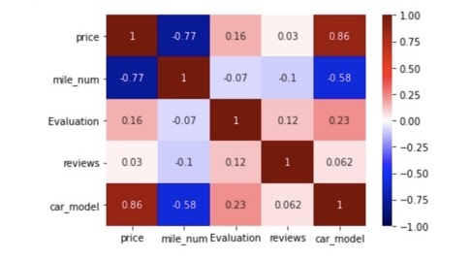
Sns heatmap: price,mile_num,Evaluation,reviews,car_model

Slide 5
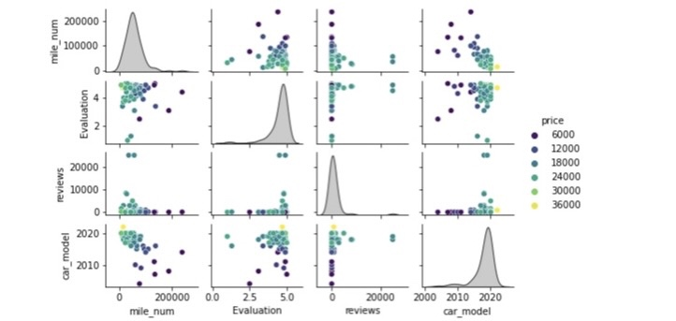
pairplot: price and mile_num,Evaluation,reviews,car_model

Slide 6
Thank you

